Slide 1
Cancellation of Debt – Principal Residence
Pub 4491: pg 2-8 – 2-19
Pub 4012: pg D-49 – D-52
Notes:
1
Minor edits to wording or formats

Slide 2
Cancelled Debt
Generally, debt for which taxpayer is personally liable that is canceled or forgiven is considered income
No income from canceled debt if the cancellation or forgiveness of debt is a gift or bequest

Slide 3
COD – Principal Residence
Taxpayers may exclude from income certain debt forgiven or canceled on their principal residence
This exclusion extended through 2016
Notes:
Ends (at this point) December 31, 2016

Slide 4
Qualified Principal Residence Indebtedness
Any debt incurred in acquiring, constructing, or substantially improving a principal residence that is secured by principal residence
Any debt secured by principal residence resulting from refinancing of debt incurred to acquire, construct, or substantially improve a principal residence, but only to extent that amount of debt does not exceed amount of old indebtedness

Slide 5
Recourse versus Nonrecourse Debt
 | Recourse Debt | Nonrecourse Debt
Borrower is… | Personally liable | Not personally liable
Canceled portion of debt is generally… | Treated as ordinary income and included in gross income (unless it qualifies as exception or exclusion) | Nonrecourse debt is satisfied by surrender of secured property regardless of FMV at time of surrender
Gain or loss on disposition of the property | Generally determined by difference between FMV of property and adjusted basis | Amount realized includes balance of nonrecourse debt at time of disposition of property (even if FMV of property is less than outstanding debt)

Slide 6
Debt Forgiveness In-scope if:
Home never used in a business or as rental property
Debt not canceled because taxpayer filed bankruptcy
Taxpayer isn’t in bankruptcy when he/she comes to site for assistance
Form 1099-C doesn’t include an amount for interest
Debt was mortgage used only to buy, build, or substantially improve taxpayer’s primary residence
Mortgage was secured by taxpayer’s primary residence
Mortgage was not more than $2 million ($1 million if Married Filing Separately)

Slide 7
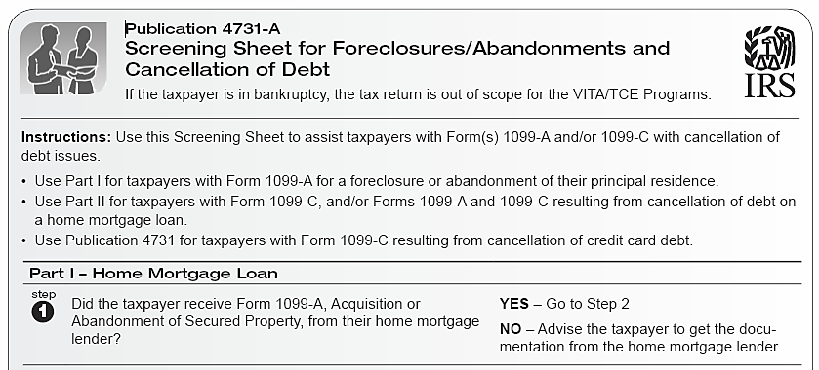
Job Aide: Pub 4731-A
Pub 4012 pg D-50

Slide 8
Intake/Interview

Slide 9
Cancellation of Debt – Principal Residence
For property taken by the lender (foreclosure) or given up by the borrower (abandonment), lender usually sends taxpayer Form 1099-A – Acquisition or Abandonment of Secured Property
If debt is canceled, the taxpayer will receive Form 1099-C – Cancellation of Debt.
If foreclosure/abandonment and debt cancellation occur in the same calendar year, the lender may issue only Form 1099-C

Slide 10
Treated as Sale
Foreclosure or repossession is treated as a sale from which taxpayer may realize a gain or loss (even if taxpayer voluntarily returns property to lender)
Gain or loss must be reported on return and is subject to rules for Sale of Residence (another lesson)
Generally, amount realized on a foreclosure is considered to be the selling price
But this selling price depends, in part, on whether debt was recourse debt or nonrecourse debt
And, taxpayer may also have ordinary income from the cancellation of debt

Slide 11
COD Income
If recourse debt and amount of outstanding debt (mortgage) is more than home’s FMV, difference is treated as cancellation of debt income
If canceled debt qualifies as excludable from gross income, exclusion is reported on Form 982
Otherwise, canceled debt is out of scope

Slide 12
Foreclosure
Recourse debt
Borrower personally liable – Form 1099-A box 5
Box 2 shows balance of debt outstanding
Box 4 shows FMV of property
Lesser of box 2 or box 4 is the sales price listed on Form 8949
Nonrecourse debt
Box 2 is always sales price (full balance of debt outstanding) that is listed on Form 8949
Notes:
12

Slide 13
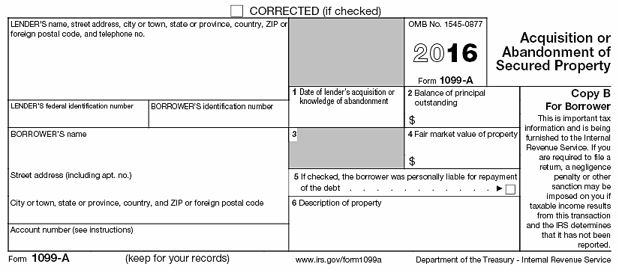
Form 1099-A

Slide 14
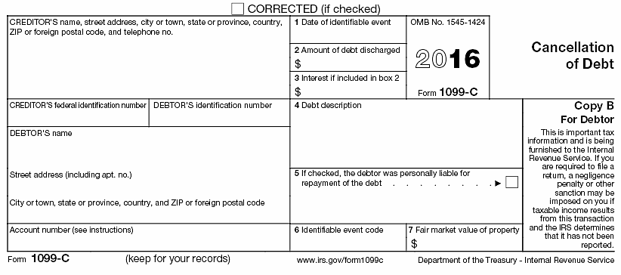
Form 1099-C

Slide 15
Cancellation of Qualified Debt Reporting – Recourse Debt
Taxpayer will receive Form 1099-C
Box 2 shows amount of debt forgiven
If form has event code “A” indicating bankruptcy, or if amount is included for interest, – out of scope
Must complete Form 982 and attach to return
If foreclosure, complete only boxes 1E and 2.
If ownership retained, also complete box 10b
No income reported on Line 21, Form 1040
Notes:
15

Slide 16
Example
Mary purchased her main home in June 2009 for $175,000
In early 2016 she lost her job and was no longer able to make her payments on her recourse mortgage
In July, Mary moved out of the home to live with relatives
On Oct 15, 2016 the bank foreclosed on the home and canceled the remaining amount owed on the home
The fair market value at the time was $100,000, but Mary still owed $150,000 on the mortgage
None of the loan proceeds were used for any purpose other than to buy, build, or substantially improve the principal residence
Notes:
16
16

Slide 17
1099-C
10/15/2016
50,000
Home Mortgage
X
100,000

Slide 18
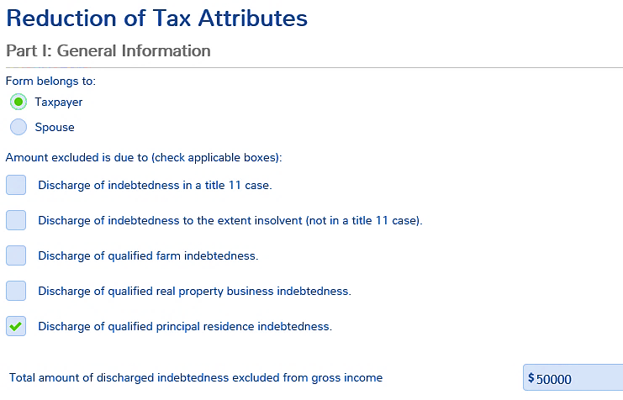
Form 982 Part I
Select who received 1099-C
Box 2 Amount
Notes:
18

Slide 19
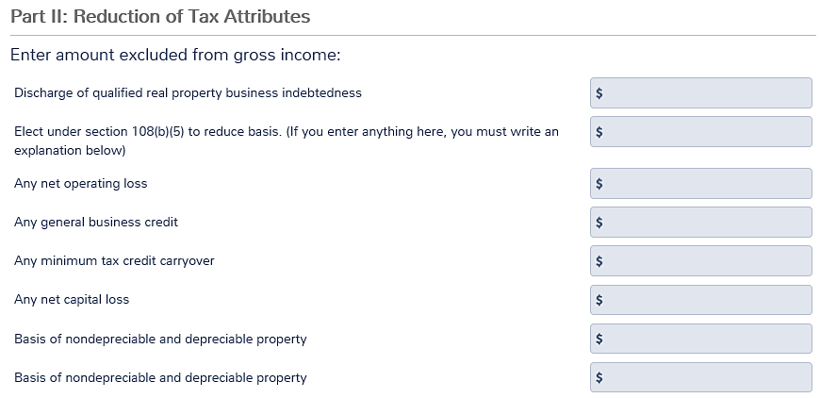
Form 982 Part II
Enter debt cancelled ONLY if taxpayer retained possession of home

Slide 20
Schedule D Reporting of Nonrecourse Debt
To compute realized gain or loss due to foreclosure of nonrecourse debt, amount of debt cancelled is the sale price
A gain can be offset by Section 121 if the conditions are met for exclusion
If loss occurs due to foreclosure of personal residence, it is a nondeductible loss

Slide 21
Nonrecourse Debt
No cancellation of debt if nonrecourse
No 1099-C issued
Do not complete Form 982
Selling price on Schedule D is Box 2 of 1099-A (full amount of debt cancelled)

Slide 22
Quality Review
Was debt recourse or nonrecourse?
Was home disposed or does taxpayer still have it?
Is there excludible COD income?
Verify results on 1040 and 982 (if any)

Slide 23
COD – Principal Residence
Questions?
Comments…

